Slide 1
CSE/PC/B/T/316 Computer Networks Topic 5- Multiple Access Protocols (CSMA-CD, CSMA-CA)
Sarbani Roy
sarbani.roy@jadavpuruniversity.in
Office: CC-5-7
Cell: 9051639328

Slide 2
Problem in CSMA
The CSMA method does not specify the procedure following a collision.

Slide 3
CSMA with Collision Detection (CSMA/CD)
To overcome the problem of CSMA, CSMA with collision detection i.e., CSMA/CD augments the algorithm to handle the collision.
In CSMA/CD, a station monitors the medium after it sends a frame to see if the transmission was successful. If so, the station is done. If however, there is a collision the frame is sent again.

Slide 4
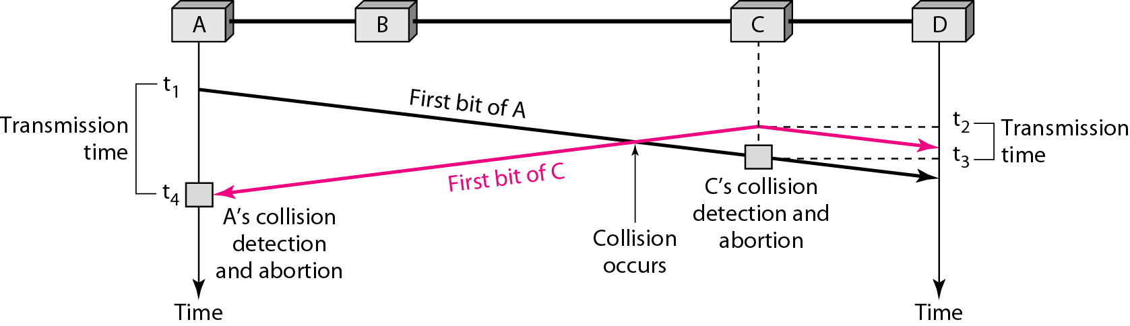
Collision of the first bit in CSMA/CD

Slide 5
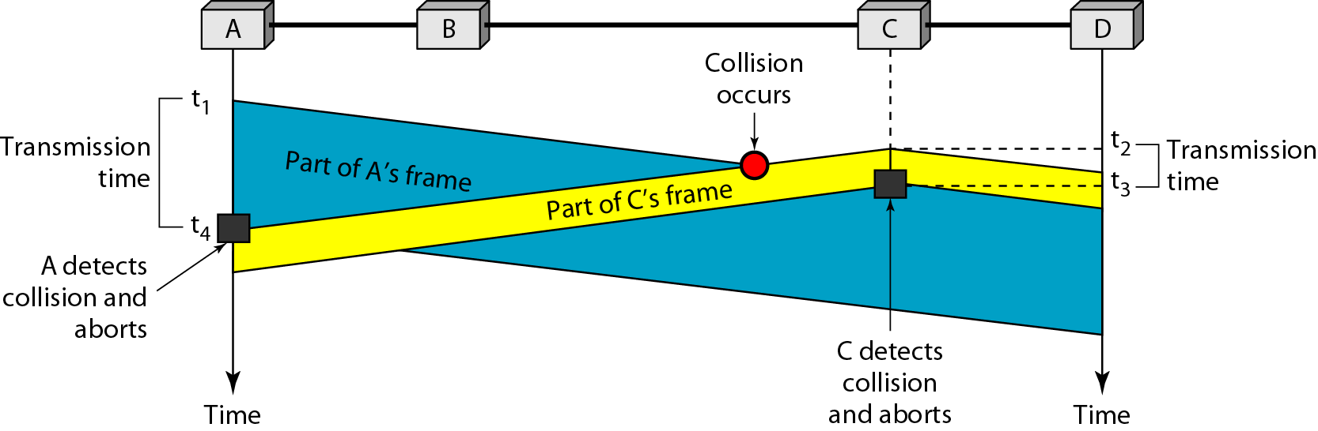
Collision and abortion in CSMA/CD

Slide 6
Minimum Frame Size
For CSMA/CD to work, we need a restriction on the frame size. Before sending the last bit of the frame, the sending station must detect a collision, if any, and abort the transmission.
This is so because the station, once the entire frame is sent, does not keep a copy of the frame and does not monitor the line for collision detection.
Therefore, the frame transmission time Tfr must be at least two times the maximum propagation time Tp.
If the two stations involved in a collision are the maximum distance apart, the signal from the first takes time Tp to reach the second, and the effect of the collision takes another time Tp to reach the first. So the requirement is that the first station must still be transmitting after 2Tp

Slide 7
Problem
A network using CSMA/CD has a bandwidth of 10 Mbps. If the maximum propagation time (including the delays in the devices) is 25.6 μs, what is the minimum size of the frame?

Slide 8
Solution
The frame transmission time is T_{fr} = 2 × T_{p} = 51.2 μs. This means, in the worst case, a station needs to transmit for a period of 51.2 μs to detect the collision. The minimum size of the frame is 10 Mbps × 51.2 μs = 512 bits or 64 bytes. This is actually the minimum size of the frame for Standard Ethernet.

Slide 9
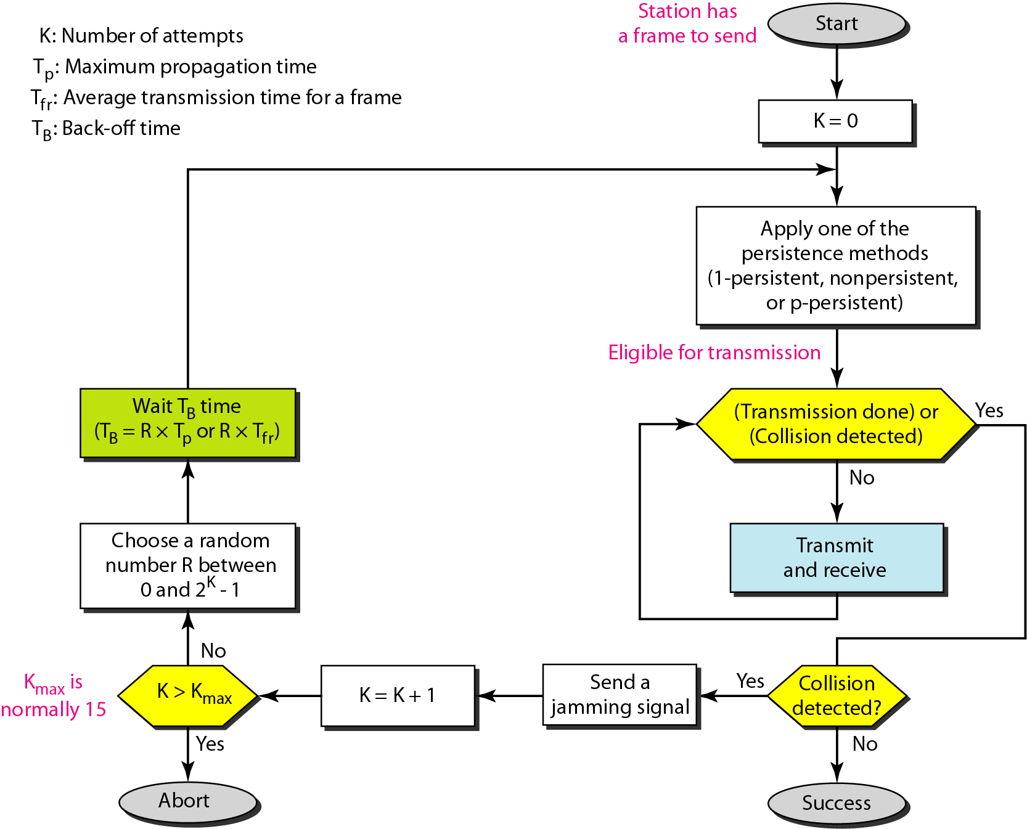
Flow diagram for the CSMA/CD

Slide 10
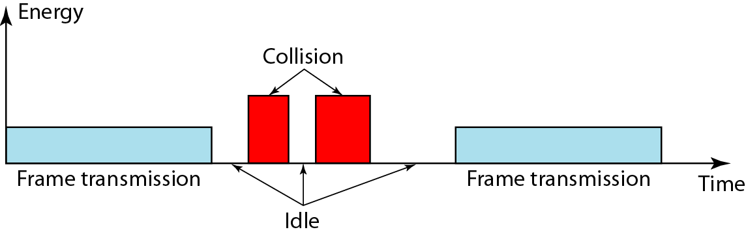
Energy level during transmission, idleness, or collision
The level of energy in a channel can have three values: zero (idle), normal (busy i.e., transmission) and abnormal (collision)

Slide 11
Basic idea behind Collision Detection
The basic idea behind CSMA/CD is that a station needs to be able to receive while transmitting to detect a collision.
When there is no collision , the station receives one signal i.e., its own signal.
When there is a collision, the station receives two signal; its own signal and the signal transmitted by the second station.
To distinguish between these two cases, the received signals in these two cases must be significantly different.
In other words, the signal from the second station needs to add a significant amount of energy to the one created by the first station.

Slide 12
If it’s a wired network …
In a wired network, the received signal has almost the same energy as the sent signal because either the length of the cable is short or there are repeaters that amplify the energy between the sender and the receiver.
This means, that in a collision, the detected energy almost doubles.

Slide 13
What if it’s a wireless network…
In a wireless network, much of the sent energy is lost in transmission (due to propagation, pathloss).
The received signal has very little energy.
Therefore, a collision may add only 5 to 10 percent additional energy.
This is not useful for effective collision detection

Slide 14
Why does CSMA/CD fail in wireless networks?
Signal strength decreases proportional to the square of the distance …obstacles attenuate the signal even further
The sender may now apply carrier sense and detect an idle medium
The sender starts sending but a collision happens at the receiver due to a second sender
It might be the case that a sender cannot “hear” the collision, i.e., CD does not work
The sender detects no collision and assumes that the data has been transmitted without errors, but a collision might actually have destroyed the data at the receiver.

Slide 15
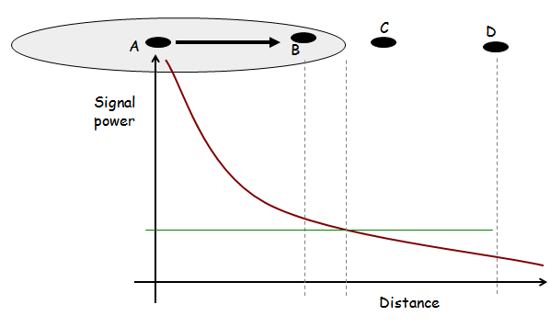
Wireless Medium Access Control

Slide 16
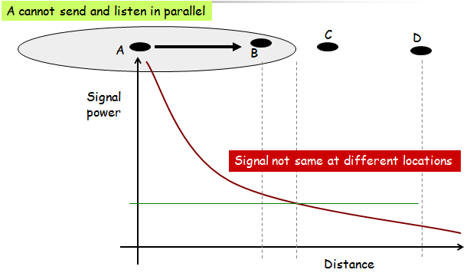
Wireless Media Disperse Energy

Slide 17

Collision Detection Difficult
Signal reception based on SINR
Transmitter can only hear itself
Cannot determine signal quality at receiver

Slide 18
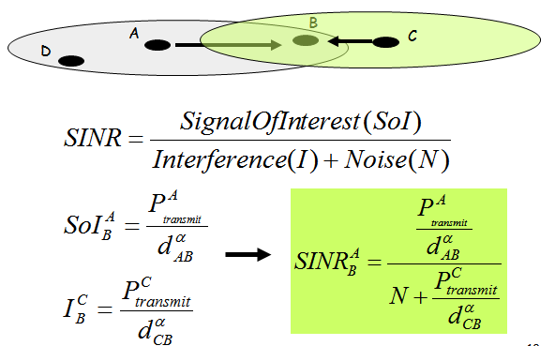
Calculating SINR

Slide 19
Issues
The main issues need to be addressed while designing a MAC protocol for ad hoc wireless networks:
Hidden and exposed terminal problems:
Hidden nodes:
Hidden stations: Carrier sensing may fail to detect another station.
Fading: The strength of radio signals diminished rapidly with the distance from the transmitter.
Exposed nodes:
Exposed stations: B is sending to A. C can detect it. C might want to send to E but conclude it cannot transmit because C hears B.
Collision masking: The local signal might drown out the remote transmission.
Error-Prone Shared Broadcast Channel
Distributed Nature/Lack of Central Coordination
Mobility of Nodes: Nodes are mobile most of the time.

Slide 20
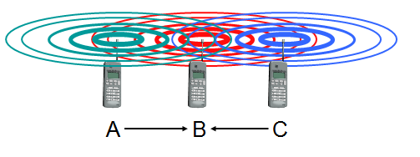
Motivation – Hidden Terminal Problem
A sends to B, C cannot receive A
C wants to send to B, C senses a “free” medium (CS fails)
collision at B, A cannot detect the collision (CD fails)
A is “hidden” for C

Slide 21
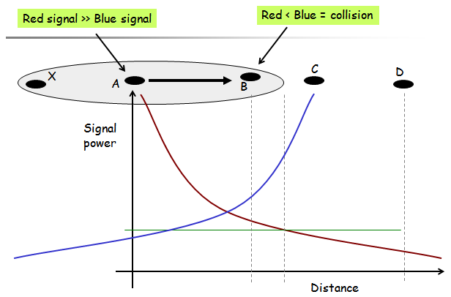

Slide 22
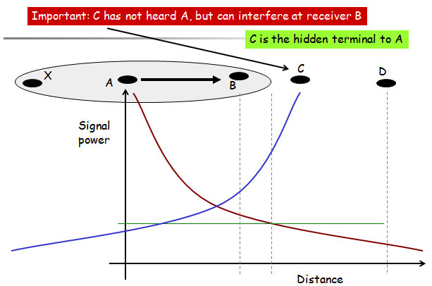

Slide 23
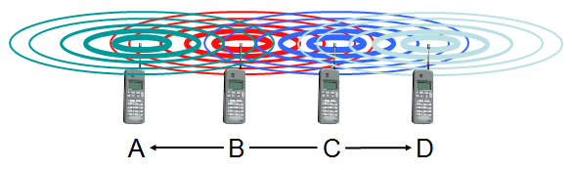
Motivation – Exposed Terminal Problem
B sends to A, C wants to send to D
C has to wait, CS signals a medium in use
since A is outside the radio range of C (waiting is not necessary)
C is “exposed” to B

Slide 24
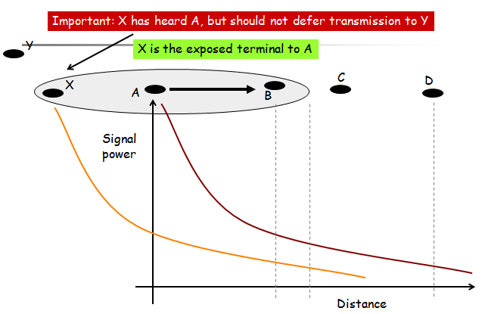

Slide 25
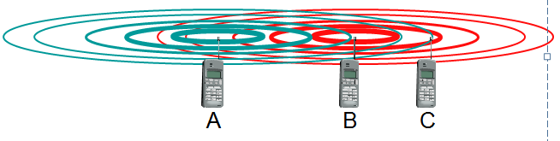
Motivation - Near and Far Terminals
Terminals A and B send, C receives
the signal of terminal B hides A’s signal
C cannot receive A
This is also a severe problem for CDMA networks
precise power control required

Slide 26
Solutions
Busy Tone
A receiver transmits busy tone when receiving data
All nodes hearing busy tone keep silent
Avoids interference from hidden terminals
Requires a separate channel for busy tone

Slide 27
CSMA with Collision Avoidance (CSMA/CA)
We need to avoid collisions on wireless networks because they cannot be detected.
CSMA/CA was invented for this network.
Collisions are avoided through the use of CSMA/CA’s three strategies:
The interframe space
The contention window
Acknowledgements

Slide 28
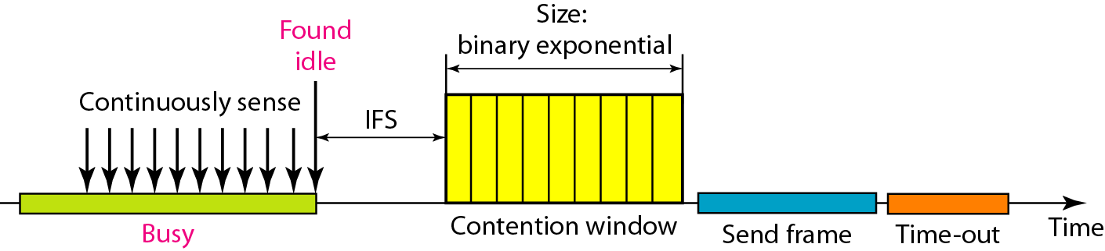
Timing in CSMA/CA

Slide 29
Interframe space
Collisions are avoided by deferring transmission even if the channel is found idle.
When an idle channel is found, the station does not send immediately. It waits for a period of time called the interframe space or IFS.
Even though the channel may appear idle when it is sensed, a distant station may have already started transmitting.
The distant station’s signal has not yet reached this station.
The IFS time allows the front of the transmitted signal by the distant station to reach this station.
If after the IFS time the channel is still idle, the station can send, but it still needs to wait a time equal to the contention time.
The IFS variable can also be used to prioritize stations or frame types. For example, a station that is assigned a shorter IFS has a higher priority.

Slide 30
Contention window
The contention window is an amount of time divided into slots.
A station that is ready to send choose a random number of slots as its wait time.
The number of slots in the window changes according to the binary exponential back-off strategy.
This means that it is set to one slot the first time and then doubles each time the station cannot detect an idle channel after the IFS time. This is very similar to the p-persistent method except that a random outcome defines the number of slots taken by the waiting station.
In CSMA/CA, if the station finds the channel busy, it does not restart the timer of the contention window; it stops the timer and restarts it when the channel becomes idle.
This gives priority to the station with the longest waiting time.

Slide 31
Acknowledgement
With all these precautions, there still may be a collision resulting in destroyed data.
In addition, the data may be corrupted during the transmission.
The positive acknowledgement and the time-out timer can help guarantee that the receiver has received the frame.

Slide 32
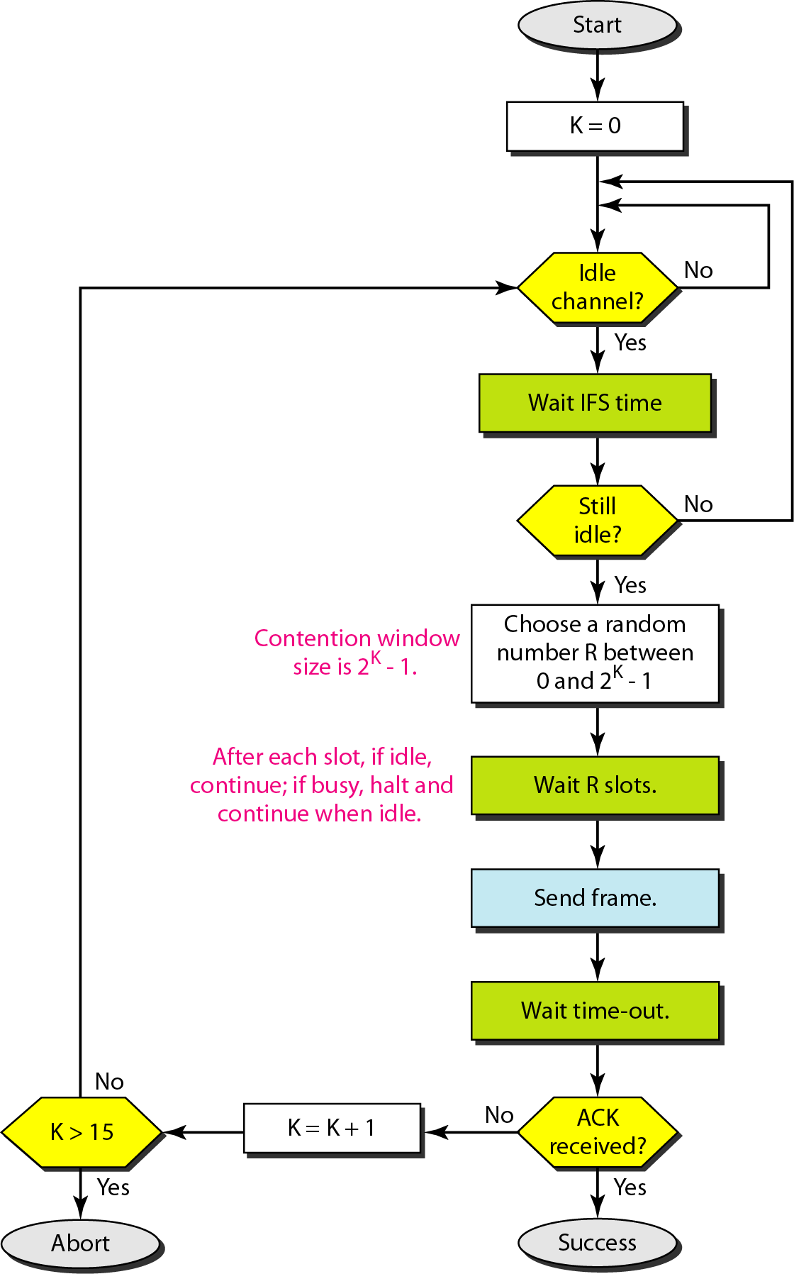
Flow diagram of CSMA/CA

Slide 33
MACA
MACA (Multiple Access Collision Avoidance )
When node A wants to send a packet to node B, node A first sends a Request-to-Send (RTS) to B
On receiving RTS, node B responds by sending Clear-to-Send (CTS), provided node B is able to receive the packet
If a packet transmitted by a node is lost, the node uses the binary exponential back-off (BEB) algorithm to back off a random interval of time before retrying
When a node (such as C) overhears a CTS, it keeps quiet for the duration of the transfer
Transfer duration is included in RTS and CTS both

Slide 34
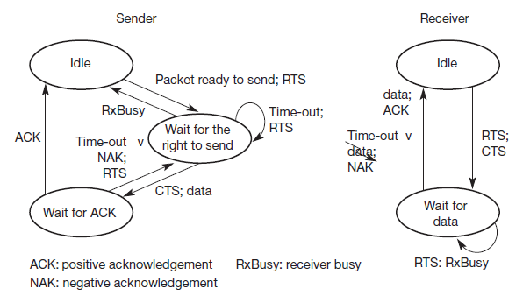
Simplified state machines for a sender and receiver

Slide 35
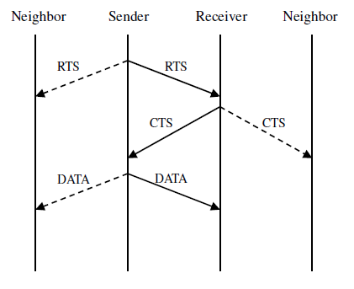
Packet transmission in MACA

Slide 36
Receiver informs interferers before transmission – MACA
Sender B asks receiver C whether C is able to receive a transmission Request to Send (RTS)
Receiver C agrees, sends out a Clear to Send (CTS)
Potential interferers overhear either RTS or CTS and know about impending transmission and for how long it will last
Store this information in a Network Allocation Vector
B sends, C acks
! MACA protocol (used e.g. in IEEE 802.11)

Slide 37
RTS/CTS
RTS/CTS ameliorate, but do not solve hidden/exposed terminal problems

Slide 38
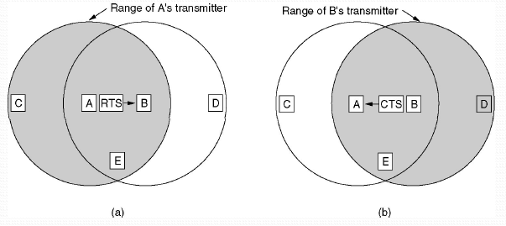
The MACA protocol
(a) A sending an RTS to B (b) B responding with a CTS to A

Slide 39
Backoff Interval
Backoff intervals used to reduce collision probability
When transmitting a packet, choose a backoff interval in the range [0,cw]
cw is contention window
Count down the backoff interval when medium is idle
Count-down is suspended if medium becomes busy
When backoff interval reaches 0, transmit RTS

Slide 40
Backoff Interval
The time spent counting down backoff intervals is a part of MAC overhead
Choosing a large cw leads to large backoff intervals and can result in larger overhead
Choosing a small cw leads to a larger number of collisions (when two nodes count down to 0 simultaneously)

Slide 41
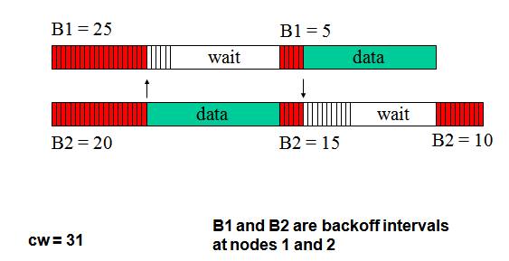
Example

Slide 42
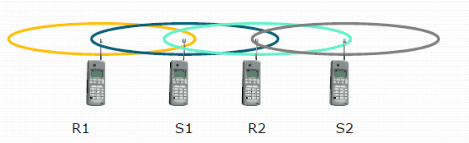
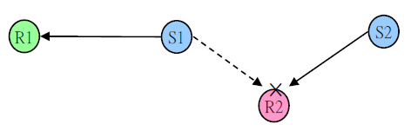
Problem with MACA
The binary exponential back-off mechanism used in MACA might starve flows sometimes
The problem is solved by MACAW

Slide 43
Solution
Back-off algorithm has been modified by Bharghavan in 1994
Packet header has an additional filed carrying the current back-off counter value of the transmitting node
A node receiving the packet copies this value into its own back-off counter
To prevent large variations in the back-off values
A multiplicative increase and linear decrease (MILD) is used in MACAW
Collision: back-off is increased by a multiplicative factor (1.5)
Successful: back-off is decreased by one
Implement per flow fairness as opposed to the per node fairness
Multiple queues at every node (running backoff algorithm independently)

